Slide 1
story 3
File created on: 10/28/2023 3:27:44 PM

Slide 2
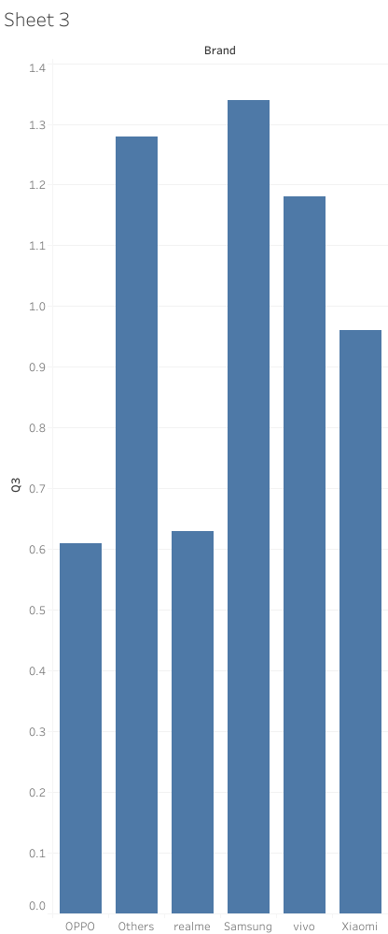

Slide 3
